Slide 1
Effect of climate change interventions on pear quality using Ecotron units
-
Experimental Design and Sample Size Calculation
PMHD Project - Group 10
Apu Chandra Bhowmick
Basma Lusta
Olurotimi Koleowo
Omar Ben Gadha
7 April 2025

Slide 2
Contents
Introduction
Research Question and Objectives
Study design
Hypothesis Test
Statistical Model / Analysis
Observation of Pilot Data
Parameters for Sample Size Calculation
Power Test-Based Sample Size Calculation
  Visualization of Sample Size Calculation
  Sample Size Analysis
Simulation-Based Sample Size Calculation
  Visualization of Sample Size Calculation
  Sample Size Analysis
Ecotron Capacity & Allocation
Summary

Slide 3
Introduction
Climate change poses increasing challenges to agricultural productivity and food quality worldwide.
Controlled-environment studies allow researchers to simulate future climate conditions and understand their impact on crops.
This project uses Ecotron technology to simulate different climate scenarios and study their effects on pear production in Belgium.

Slide 4
Research Question and Objectives
Research Question: Which climate scenario improves pear quality the most?
Overall Objective: Study different climate change interventions on fruit production in Belgium.
Study Objective: Identify the most favorable climate intervention for the best pear quality.

Slide 5
Study design
Control group: Climate scenario 1.
Intervention groups: Climate scenarios 2, 3, 4.
Blinding: Single-blind — quality assessors were unaware of the climate scenario per Ecotron.
Randomization: Stratified block randomization was used: climate scenarios were randomly assigned to Ecotron units, with equal pear species (3 trees per species) within each unit.
Duration/End of study: Continue harvesting until the last harvestable pear is harvested.
Experimental units: The harvested pears.

Slide 6
Hypothesis Test
Null Hypothesis (H₀):
There is no significant difference in mean pear quality between climate intervention scenarios. The effect of climate change interventions on pear quality are the same/equal.
H₀ : μ₁ = μ₂ = µ₃ = µ₄​
Alternative Hypothesis (H₁):
At least one climate intervention mean scenario significantly improves pear quality compared to the control scenario.
H₁ : μ_{i} > μ₁ for at least one i ( i = 2, 3, 4)

Slide 7
Statistical Model — Linear Mixed Effects Model (LMM)
Y_{ki} = β₀ + β₁*(Scenario)_{2k} + β₂*(Scenario)_{3k} + β₃*(Scenario)_{4k} + β₄*(Variety)_{k} + b_{k} + ε_{ki}
Where:
Y_{ki} = Quality score of pear i from tree k
β₀ = Control groups (climate scenario 1 and pear variety: Conference)
β₁, β₂, β₃= Fixed effects of different climate intervention scenarios compared to the control
β₄ = Fixed effect of pear variety
b_{k} = Random effect for trees N(0, σ²_{k})
ε_{ki}= Residual error i.i.d N(0, σ²_{ki})
Notes:
We need to add model name here

Slide 8
Pilot Data Summary
Purpose: to estimate the mean and standard deviation (SD) of pear quality to inform sample size calculations
Total pears: 591
Source: Collected from Ecotron units under climate scenario 1 (Control group)
Varieties: Conference & Doyenne du Comice
Quality scale: 0 to 100

Slide 9
Parameters for Sample Size Calculation
Significance level (α): 0.05
Mean value : 51.08
Standard Deviation: 35.9
Effect size: from 10 to 25
Power level: from 80% to 90%

Slide 10
Sample Size Estimation Methods
1. Power Test-Based Sample Size Calculation Method
Used R’s power.t.test() function
One-sided two-sample t-test
Inputs:
  Effect size (10 -25)
  P-value : 0.05
  Standard deviation from pilot data
  Target power (80% - 90%)
Output
  required sample size per group

Slide 11
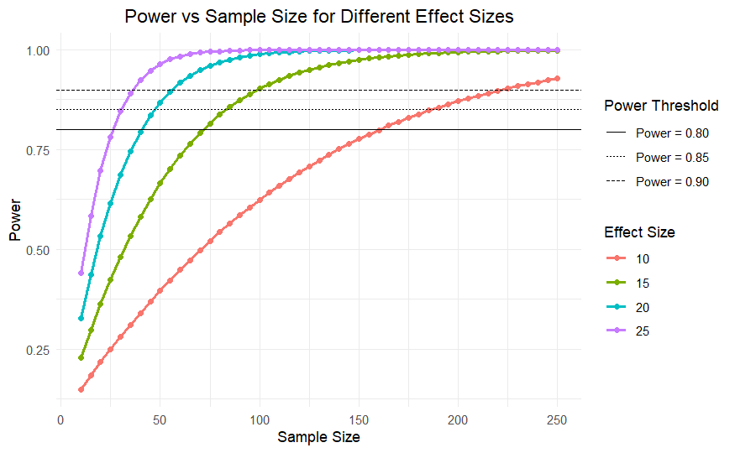
Visualization of Sample Size Calculation

Slide 12
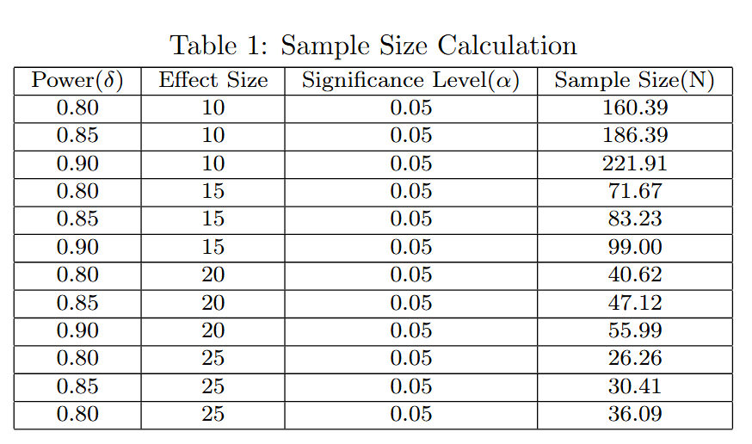
Power Test-Based Sample Size Table
Table 1: the sample size of different level of power, effect size (10-25), and significance level of (0.05)

Slide 13
Sample Size Estimation Methods
2- Simulation-Based Sample Size Calculation Method
Simulated data for Control and 3 Climate Scenarios
Quality scores assumed to follow a normal distribution.
- Mean and standard deviation taken from pilot data
For each simulation:
  Performed three one-sided t-tests (each scenario vs. control)
  Applied Bonferroni correction for multiple comparisons (0.05 / 3)
  Counted as a success if at least one scenario significantly outperformed control
Estimated power = Proportion of successful simulations

Slide 14
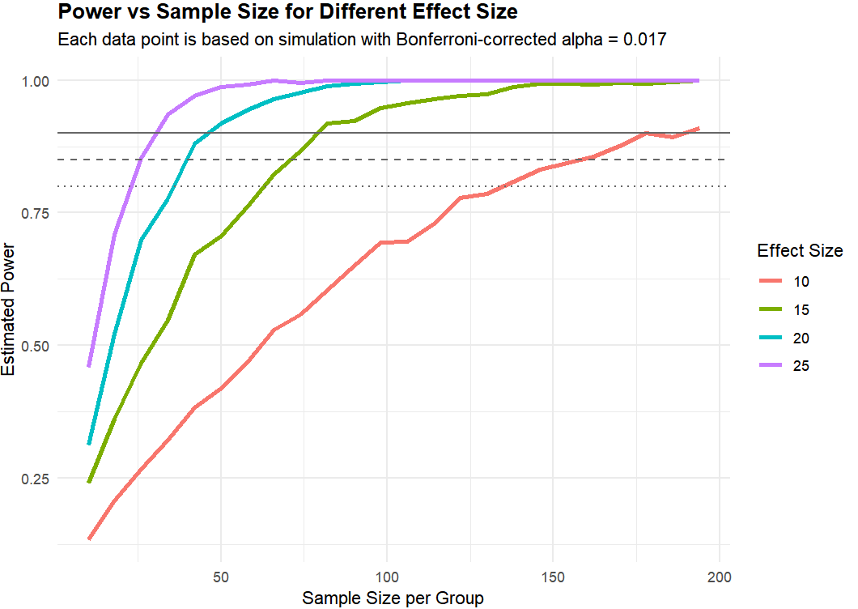
Visualization of Sample Size Calculation

Slide 15
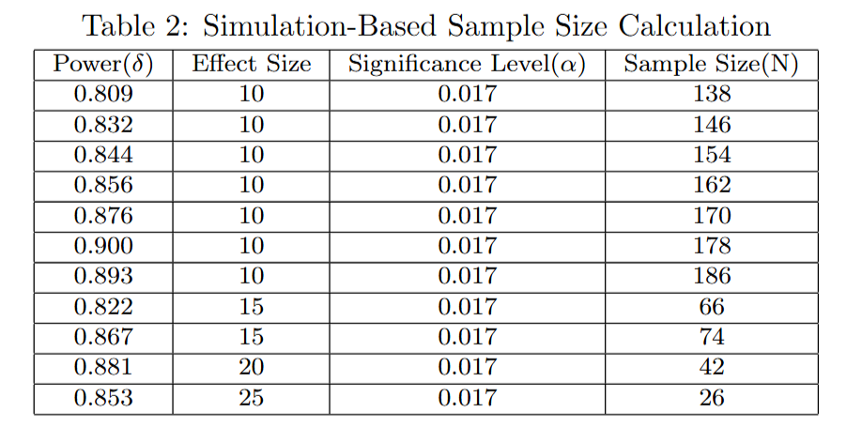
Simulation-Based Sample Size Table
Table 2 : Estimated Sample Sizes by Effect Size and Power (Bonferroni α = 0.017)

Slide 16
Ecotron Capacity & Allocation
12 Ecotron units available in Belgium.
12 optional Ecotron units available in France if needed.
Each Ecotron unit can contain 6 trees at maximum.
Each tree produces 30–40 pears per yield.
Therefore, each unit yields:
  Minimum: 6 × 30 = 180 pears.
  Maximum: 6 × 40 = 240 pears.
Notes:
Given that the all the pears are in a good condition.

Slide 17
Summary
Goal: Identify the climate intervention scenario that results in the highest pear quality under controlled Ecotron conditions.
Sample Size Estimate: 160–220 pears per group depends on methods (power t-test or simulation methods).
Next Steps: Finalize Ecotron unit allocation and confirm design with sponsors and professors.

Slide 18
Thank you for your attention

